Slide 1
Internship Report
Submitted in the partial fulfillment for the award of the degree of
BACHELOR OF ENGINEERING
IN
ARTIFICIAL INTELLIGENCE AND MACHINE LEARNING
AT
HCLTech
Submitted by:
Samarjeet Singh Kalra
20BCS6598
20AIML4-A
Under the Supervision of:
Mr. Mahesh Kumar C.
General Manger
HCLTech
Department of AIT-CSE
DISCOVER . LEARN . EMPOWER

Slide 2

Agenda
Introduction to Company
Introduction to my job profile
Introduction to the Project
Problem statement, objectives and how it was achieved
Tools worked on
Observations/ work experiences during the internship
What skills (scientific and professional) were learned during the internship
Concluding Remarks (Challenges faced)
References

Slide 3
INTRODUCTION TO COMPANY

Slide 4

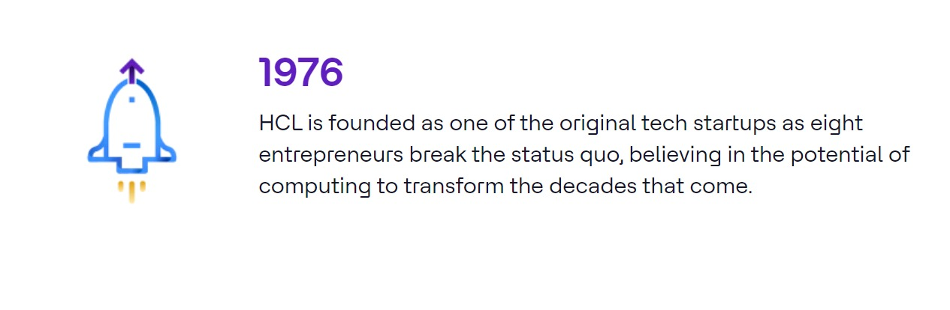
Powered by a global team of 224,700+ diverse and passionate people across 60 countries, we deliver smarter, better ways for all our stakeholders to benefit from technology.
Delivering long-lasting impact through our actions as a company and through our pacts with stakeholders for a more sustainable future.

Slide 5
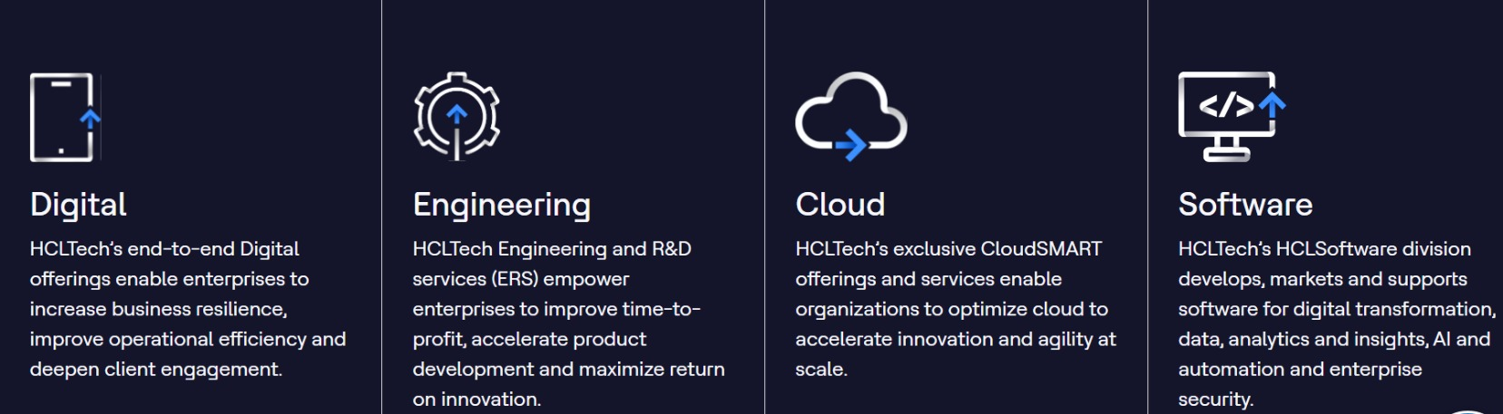
AREA OF EXPERTISE

Slide 6
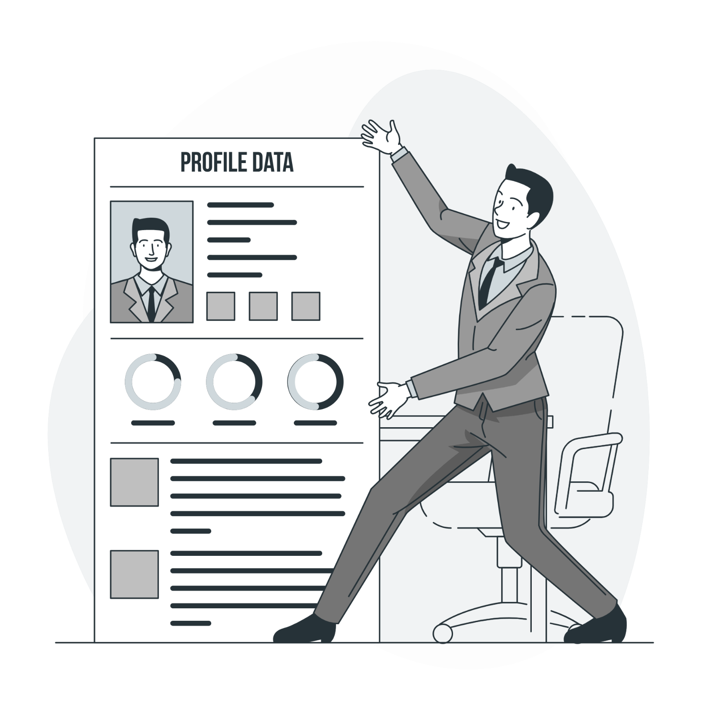
Introduction to my Job Profile

Slide 7
Tech Associate @ HCLTech
Played a pivotal role in the Intel Ecosystem Business Unit.
Focus is on developing innovative solutions that leverage Intel's technologies to drive business value for our global clientele.
Collaborate with cross-functional teams to understand client requirements and design tailored solutions that integrate Intel's value adds.
Act as a primary point of contact for clients, providing expert guidance on solution capabilities and value propositions..
Manage end-to-end project lifecycles, from requirement gathering and solution design to implementation and post-deployment support.
Monitor project progress, identify potential risks or bottlenecks, and implement mitigation strategies to ensure successful project delivery.

Slide 8
Tech Associate @ HCLTech
Analyze client requirements and translate them into actionable solution designs that leverage Intel's technologies and value adds.
Cultivate strong client relationships through regular communication, proactive problem-solving, and exemplary service delivery.
Lead project planning and execution efforts, including task allocation, timeline management, and resource coordination.
Conduct research on emerging technologies, industry best practices, and competitive trends to inform solution development strategies and roadmap.
Collaborate with software engineers, architects, and domain experts to implement solution designs and ensure alignment with project objectives.

Slide 9

ABOUT INTEL-EBU

Slide 10
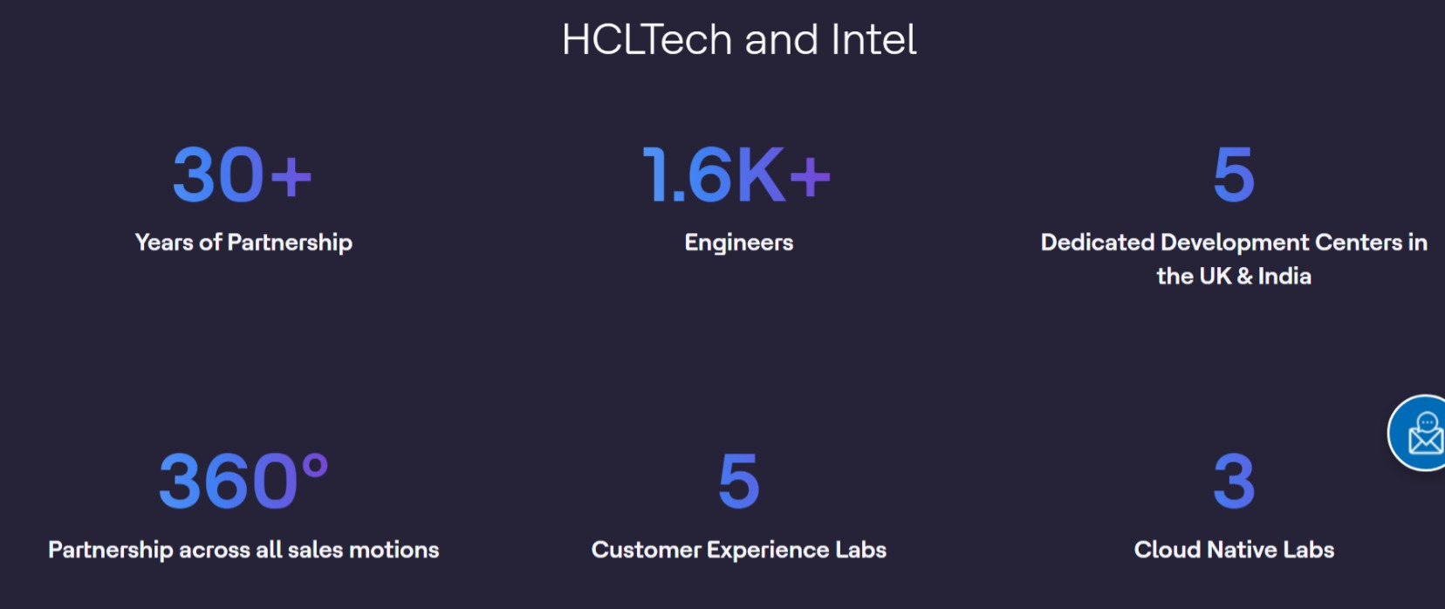
HCL Technologies established a dedicated Intel Ecosystem Unit in 2022 to strengthen their collaboration with Intel. This unit focuses on developing and delivering innovative solutions leveraging Intel's technology for HCLTech's clients. The unit's goal is to:
Build industry-specific solutions tailored for Intel clients.
Accelerate the adoption of advanced technologies like cloud, AI, and edge computing
Develop a roadmap for enterprises leveraging Intel technology for hybrid cloud, digital workplaces, and 5G networks and AI.

Slide 11
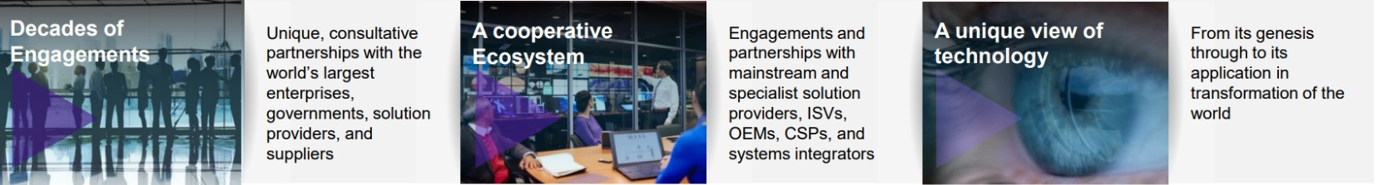
Partnering With Intel

Slide 12
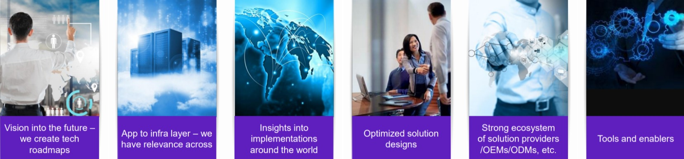
Why Intel?

Slide 13
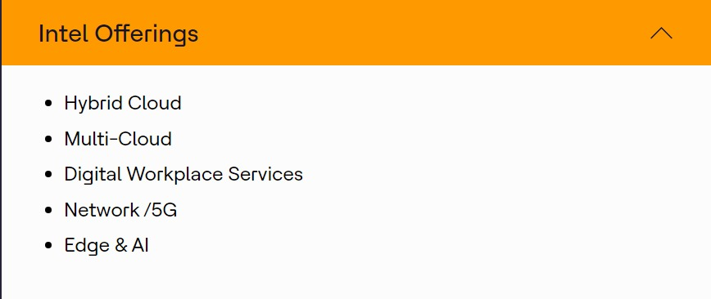
INTEL OFFERINGS

Slide 14
INTRODUCTION
TO
PROJECT

Slide 15
Confidential Computing
Confidential computing ensures that data is protected even while it's being processed.
Confidential computing can be used in conjunction with storage and network encryption, which protect data at rest and data in transit respectively.
The technology protects data in use by performing computations in a hardware-based trusted execution environment (TEE). Confidential data is released to the TEE only once it is assessed to be trustworthy.
It is often compared with other privacy-enhancing computational techniques such as fully homomorphic encryption, secure multi-party computation, and Trusted Computing.

Slide 16
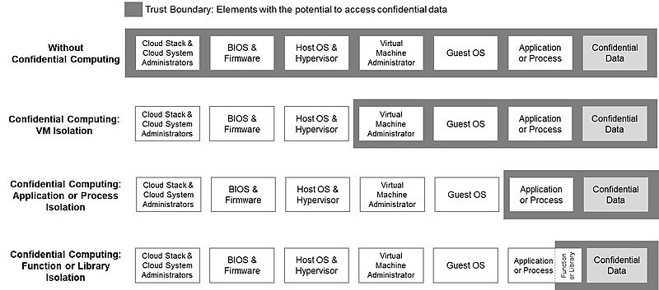

Slide 17


Problem Statement, Objectives & How it was achieved

Slide 18
Problem Statement
In an era of increasing data breaches and regulatory scrutiny, organizations face the challenge of securing sensitive data and workloads in cloud environments. Traditional security measures fall short in protecting against advanced threats and insider attacks, while cloud providers' access to data raises concerns about privacy and compliance. This project aims to address these challenges by implementing confidential computing using Google Cloud Platform (GCP) and Intel SGX technology. The objective is to create secure execution environments, known as enclaves, where sensitive data can be processed without exposure to unauthorized access, ensuring data privacy, integrity, and compliance with regulatory standards

Slide 19
Project Objectives
Secured Environment
Ensure Data Privacy
Achieve Regulatory Compliance
Evaluate Performance and Scalability

Slide 20
Confidential Computing
Outcomes:
Enhanced Data Security
POC Showcase- Intel Vision 2024
Cost Optimization

Slide 21


Executive Summary
PROBLEM STATEMENT
Traditional cloud deployments leave sensitive data vulnerable in client environments, hindering cloud adoption and potentially causing financial losses.
HCLTech can leverage confidential computing to provide a more secure cloud experience for clients, addressing compliance needs and differentiating its service offerings.
SOLUTION
Confidential computing offers a promising solution to address these data security challenges in cloud environments, ensuring data remains secure even if the underlying cloud infrastructure is compromised.
INTEL IMPACT
Hardware Isolation: Intel TDX & SGX create secure enclaves within the CPU, isolating sensitive data processing in the cloud.
Trusted Execution: Intel Trust Authority verifies the integrity of these enclaves, boosting trust in confidential computing environments.
Industry Leadership: Intel drives confidential computing standards, fostering a robust ecosystem for secure cloud solutions.

Slide 22
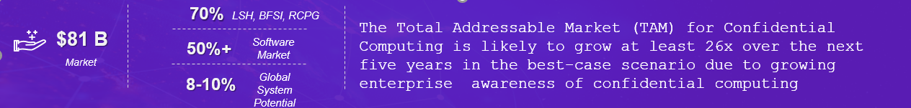
Confidential Computing: Overview

Slide 23
The 4 Key Trends Driving Confidential Computing:
Enhanced Regulatory Compliance: Meet stringent data privacy regulations (e.g., GDPR, CCPA) by ensuring data confidentiality even during processing in the cloud. This reduces compliance risks and potential financial penalties.
Strengthened Cloud Security Posture: Address growing concerns about data security in cloud environments. Confidential computing offers an additional layer of protection for sensitive data, fostering trust and encouraging broader cloud adoption for your organization.
Secure Collaboration for Sensitive Data Analysis: Enable secure collaboration and analysis of highly sensitive data for critical applications like AI and Machine Learning, unlocking new possibilities for innovation and competitive advantage.
Computational Disclosure: Protection from Computation Driven and Result Driven Disclosure – Machine Learning Privacy Principles

Slide 24
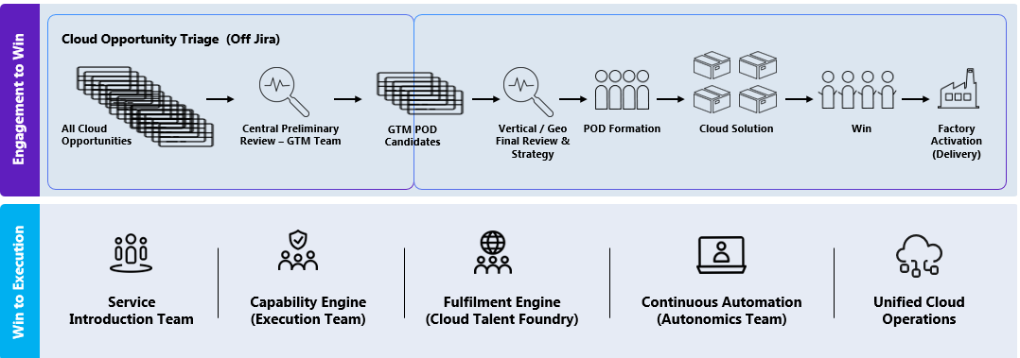
HCL proposes to include Intel Confidential computing into HCL Cloud
Data Privacy
Benefits
Advanced Threat Defense
Stronger Compliance
Unlocks Secure AI/ML
Boosts Cloud Security

Slide 25
Future Of Work- 4 Projects planned for CY24
Project 1 –GTM Enablement of Confidential Computing Solution & TaaS
Project 2 –Integration Confidential computing in Industrialized Cloud Factory Services to run Intel By default for identified service
Project 3 – Launch of Industry Solution using Intel’s SGX, TDX & TaaS under Factory Model
Certification & Enablement of resources
GTM process definition and communication for identified Hyperscalers.
Creation for Integrated Engagement model across a Cloud Service Providers
Shortlisted 1-2 mature services across HCL BUs encompassing CC.
Integration & Simulation of all services with process modeling with default Intel CC Technology
Identification of two Industry Vertical solution with a Cloud Service Provider in Health care Life Sciences & Banking, Financial Services and Insurance
Focus on Privacy preserved communication Factory Readiness for service launch
Total Project is estimated to cost USD 60K
Expected Intel contribution USD 30K
Total Project is estimated to cost USD 60K
Expected Intel contribution USD 30K
Total Project is estimated to cost USD 200K
Expected Intel contribution USD 40K
Total USD 30K
Intel part USD 10K

Slide 26
Enablement Plan
Goal
Duration
Target audience
Channels
Create Mindshare for Intel EU & promote value added offerings Solutions around Confidential Computing
Ongoing (90 day sprints)
Internal audience (HCLTech)
External Audinece (Ecosystem BU's)
Emails, Newsletters, In-person evens, Webinars
Awareness
Internal Promoation, Offering Release
Email, Newsletter, Tech-bytes
Cross Pollination
Enablement
Webinar & SPARK session
Offering assets/ Cheat sheets
Training & Certification
Social media Promotion
Tech Day
Space on Intel Ecosystem Page update
Joint TAB

Slide 27
Confidential Computing: Engagement Model
Global GSI Engagement Model – HQ / BU
360 Engagement covering Sell TO* and Sell With
Account Engagements – Influence to CSP . Account Sales force
Triangulation with CSP / Co Sell – Joint GTM for Instance Influence
Technical value prop – cheat sheet, mind maps, benchmarks, workshops, collaterals, co-engineering
Integration with Cloud Service Factory Model to accelerated time to revenue
Integration with Cloud Service Factory Model to accelerated time to revenue
From Transactional to Continuous Strategic Engagements

Slide 28





Confidential Computing: Intel Influence
Key workload for Global Customers
Making SPR ( Xeon Gen4) as a key ingredient by co-engineering
Bringing Hyperscaler to collaborate on this key solution architecture with Intel and HCLTech was a Mutual Win-Win for all the involved entities.
Collaborate together to assess technical suitability and co-engineered the overall architecture.
Document all the value prop and Content Creation
Solutioning
Cross team enablement for faster adoption of the solution. - Planned
Micro Certification to sell the solution - Planned –
Hands-on for advanced understanding and working of solution – Planned using HCLTech Lab
Professional Service Readiness for deployment and implementation -Planning
Enablement
Defining a GTM program for market outreach basis the solution and Industry
Clear definition of spiff allocation and payout. – Note Yet Defined
Marketing outreach plan : Regional, Country specific, selected set of critical customers. – Solution Launched and Intel Sellers Training Planned
Sales Cycle completion target – TBD
Solution roadmap identification and feedback to Solutioning
Go To Market
Governance & Tracking
Regular reviews and opportunities covered. - Planned
Number of POC requests. -planned
Customer Objections and Solution Fine Tuning -Planned
Pipeline build. –In Progress
Funnel Conversion and Win ration tracking. - Planned Customer testimonials - Worked out
Solution enhancement requests. - TBD
Investment to Revenue ratio tracking - TBD

Slide 29
Industrialized Cloud Services > COMPONENTS
Services Readiness Checklist
Key Areas | Services Checklist | Checklist Item Explanation
Service Presentations | Solution Presentation | Indepth explanation with technical details
 | Playbooks | Sales/Pre-sales consumption
 | Case Studies & References | Internal and external
Pricing book and guidelines | Pricing Intelligence | Competitive pricing inputs
 | Service Cost Model | Internal Cost Calculator for estimations
 | Commercial Catalogue and T&C | Customer facing offering catalogue Contractual & Legal documents
 | Margin Guidelines | Internal Margin guidelines for sales /Presales
 | Proposal Write up | High level service overview for proposal response
Service Documentation | Whitepapers | Service benefits & use cases
 | Service Descriptions | Detailed documentation for delivery teams
 | Architecture Overview | Technical Document on architecture & setup
 | Runbooks | Recorded Runbook simulation for services delivery
Technical Assets | Tool activation and Simulation | End to End Service activation and delivery
 | Standard Scripts & IP | IP based scripts & solutions
 | Reference Architectures | pre-sales, delivery
 | Trainings Content | Training & enablement content for delivery
 | Tools & Vendor solutions | Required tools & 3rd party solutions
GTM
Factory Delivery

Slide 30
What in it for Intel Sellers: Value based solution sales which will help influence Intel portfolio of Silicon & Software's*
Solutioning
Enablement
Go To Market
Governance & Tracking
Key workload for Global Customers
Making SPR ( Xeon Gen4) as a key ingredient by co-engineering
Bringing Hyperscaler to collaborate on this key solution architecture with Intel and HCLTech was a Mutual Win-Win for all the involved entities.
Collaborate together to assess technical suitability and co-engineered the overall architecture.
Document all the value prop and Content Creation
Cross team enablement for faster adoption of the solution. - Planned
Micro Certification to sell the solution - Planned –
Hands-on for advanced understanding and working of solution – Planned using HCLTech Lab
Professional Service Readiness for deployment and implementation -Planning
Regular reviews and opportunities covered. - Planned
Number of POC requests. -planned
Customer Objections and Solution Fine Tuning -Planned
Pipeline build. –In Progress
Funnel Conversion and Win ration tracking. - Planned Customer testimonials - Worked out
Solution enhancement requests. - TBD
Investment to Revenue ratio tracking - TBD
Defining a GTM program for market outreach basis the solution and Industry
Clear definition of spiff allocation and payout. – Note Yet Defined
Marketing outreach plan : Regional, Country specific, selected set of critical customers. – Solution Launched and Intel Sellers Training Planned
Sales Cycle completion target – TBD
Solution roadmap identification and feedback to Solutioning

Slide 31
Tools
Worked
On

Slide 32
Solutions Driving Business Outcomes
LibreSpace – Workplace modernization with Fluid and Smart Workplace transformation framework that enables organizations to work from anywhere, anytime, from any device with seamless and secured access
VaultNxt – A robust turnkey solution to identify and protect business critical data and applications that enables quick recovery in the event of a security breach
FlexSpace (PCaaS) – A cost-effective digital workplace experience that spans planning, deployment, support and refreshes at a cost that aligns with the enterprise budge
HyClaaS – Hybrid Cloud As a Service, a GTM delivering a structured approach to transforming IT aligned with business goals
Telco – As-a-Service Operations and Infrastructure transformation for Telcos powered by Dell Compute and Storage offering committed increase in data handling capability, TCO optimization
SAP – A joint solution offering SAP transformation with SAP RISE PECDC with deployment accelerators like BASE 90 and SAP migration factory

Slide 33
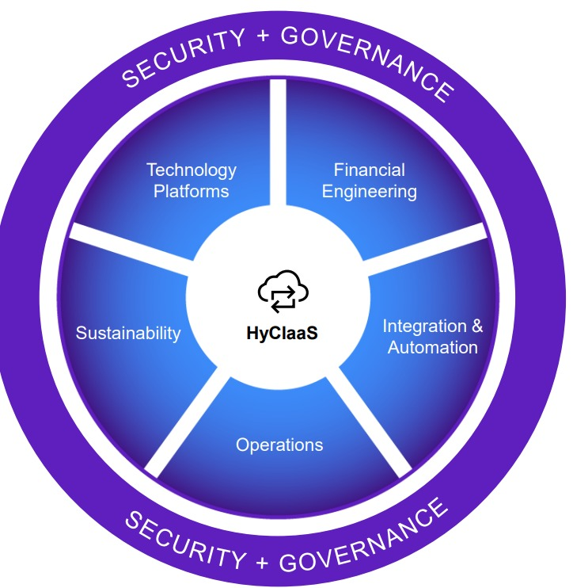
How HyClaaS enables transformation
HyClaaS combines five key elements, underpinned by security and compliance, to deliver a custom hybrid cloud solution that makes end-to-end IT transformation easier and provides a roadmap to reduce IT infrastructure c

Slide 34
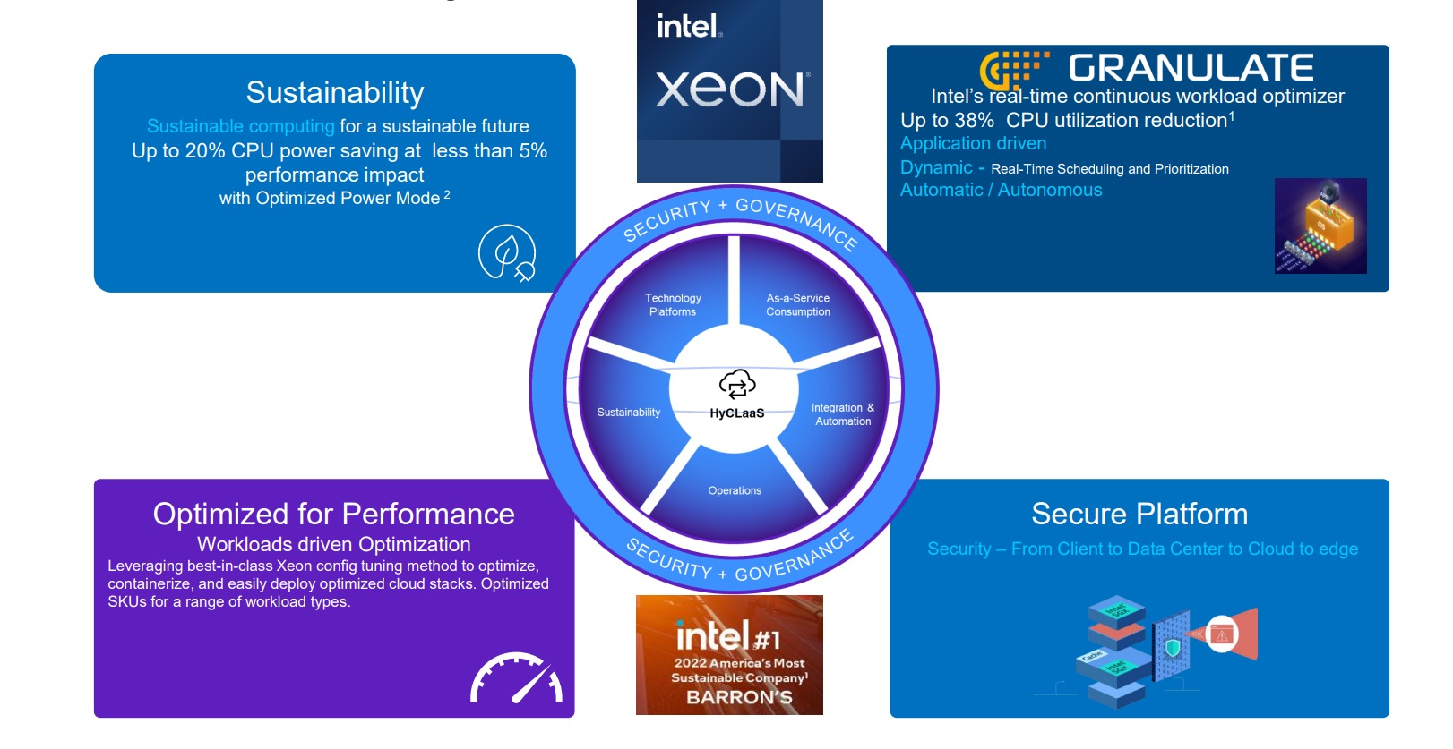
Intel Value Prop for HyClaaS

Slide 35
HyClaaS from HCLTech & Dell Technologies – powered by Intel
Hybrid Cloud as-a-Service (HyClaaS) from HCLTech and Dell Technologies, powered by Intel, is an infrastructure modernization approach that provides better application performance and cost profile and enhanced security and regulatory control.
By modernizing your IT infrastructure and moving everything to an as-a-Service platform, you get a simplified and future-proof hybrid cloud environment that delivers value, reliability, and predictability in terms of cost, service, and security.
With an optimal combination of hybrid cloud capabilities and business benefits, all delivered, managed, and consumed on a single platform, HCLTech delivers IT transformation aligned with business objectives, technology and financial requirements.

Slide 36
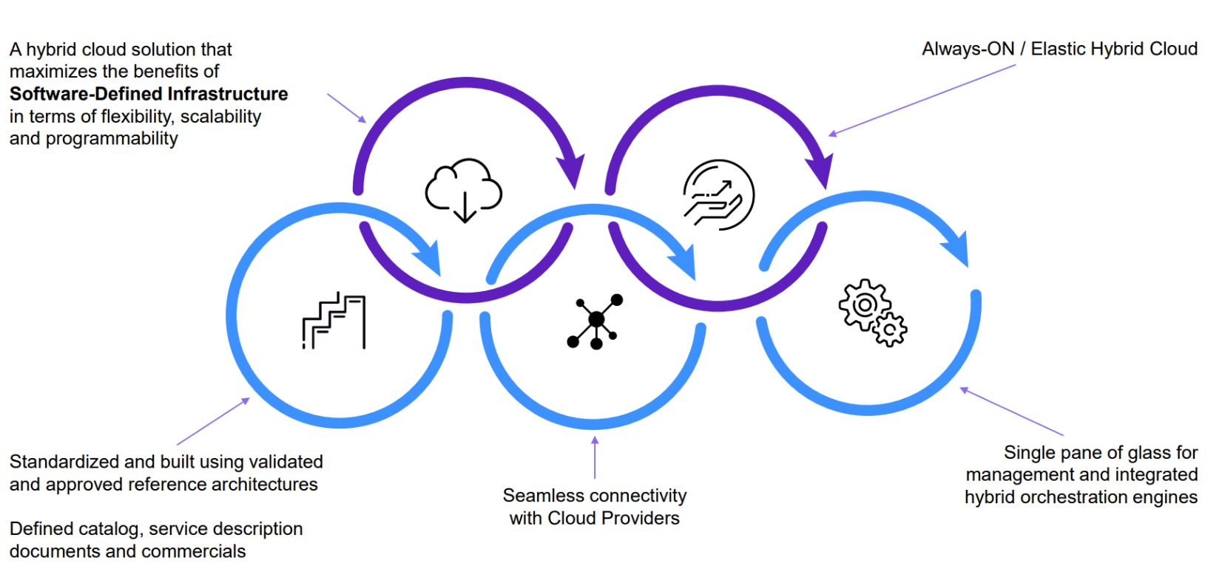
HyClaaS transforms your IT without boundaries

Slide 37
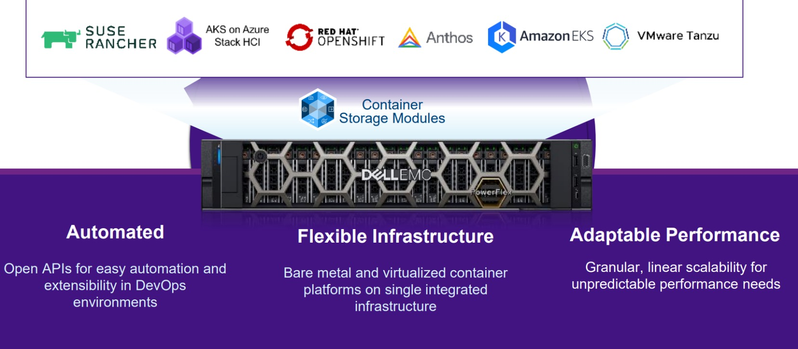
POWERFLEX
Flexible software defined infrastructure for mission critical applications

Slide 38
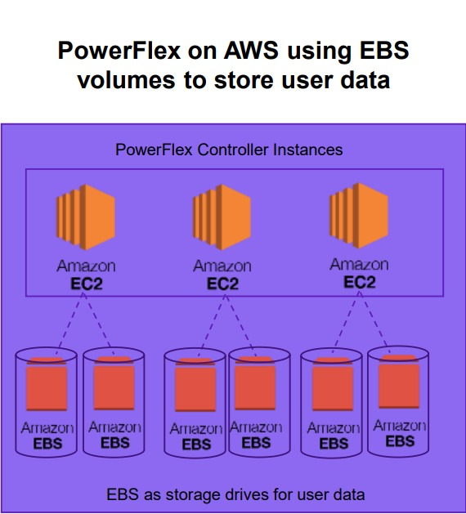
PowerFlex on AWS – Flexibility and choice
Elastic Block Storage
Persistent storage
Optimized for ease of use
Additional AWS costs
Better for on/off users

Slide 39
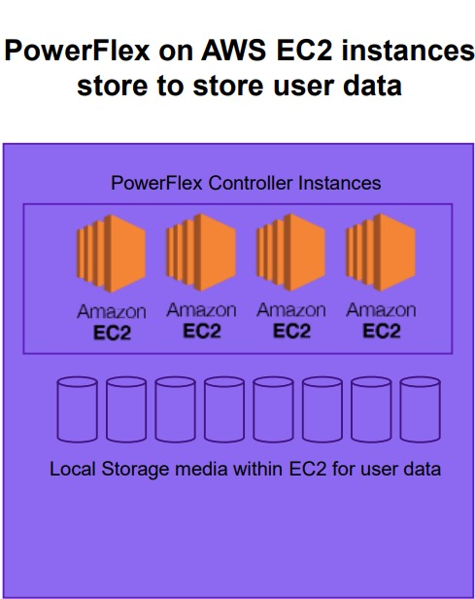
PowerFlex on AWS – Flexibility and choice
EC2 Instance store
Non persistent storage
Optimized for performance
Predictable storage costs

Slide 40
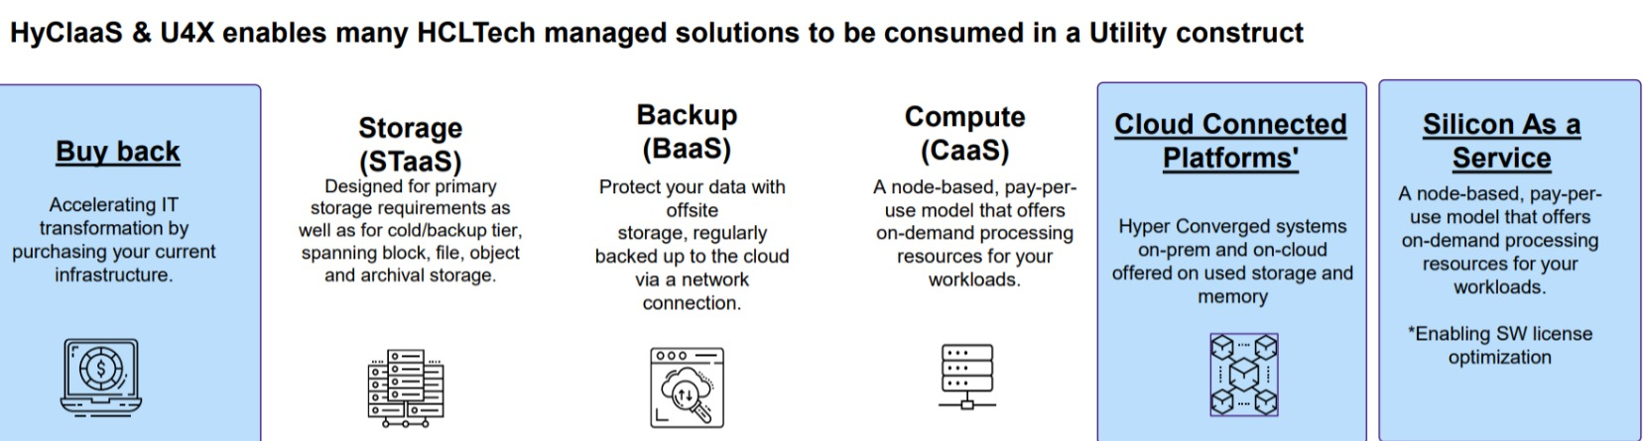
As-a-Service Consumption Accelerating IT transformation
Keeping costs predictable
By proposing a transparent Utility for Everything (U4X) contract for the infrastructure provisioned in your transformed environment, you have a payper-use subscription model that helps keep IT costs predicta

Slide 41
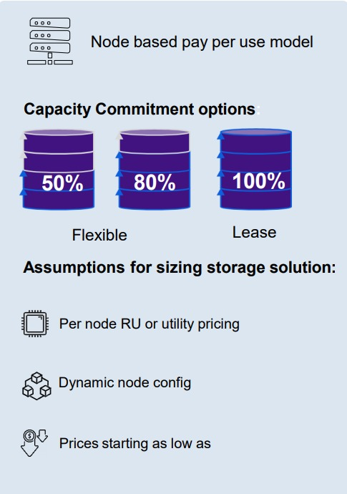
Utility Model Cloud Connected Platforms
Terms & Conditions
Minimum Commit (Volume) | Starts with min. 50% with an option to select commit level till 100% of the deployed capacity
Minimum Commit (Term) | 3/4/5 years
Min. qualification criteria | 8 Node per site
Termination charges | Equivalent to Sum of Base commit fee for remaining term

Slide 42
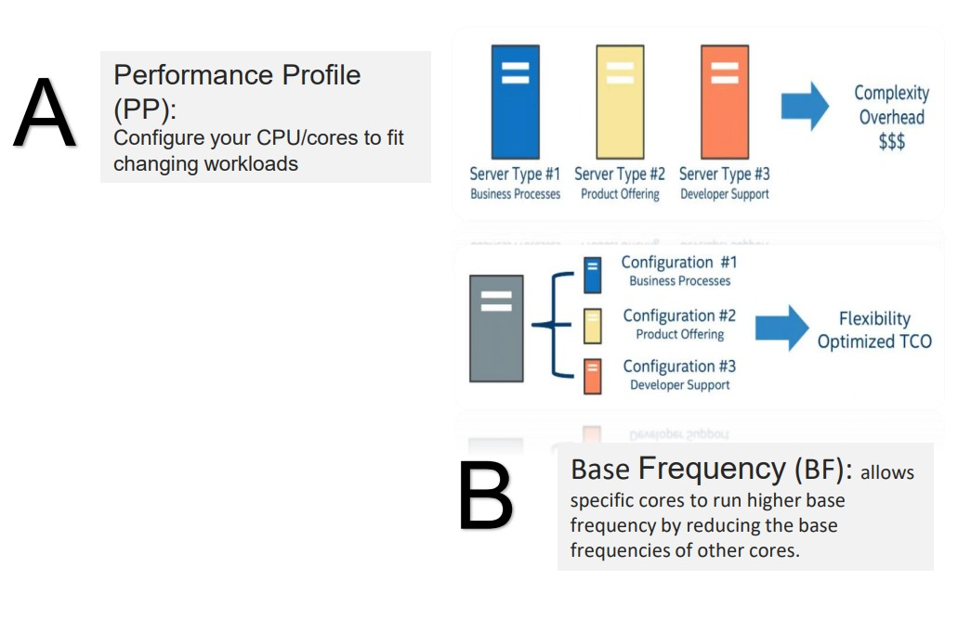
Intel® Speed Select Technology (Intel® SST)
Configure your CPU to fit changing workloads. Collection of features giving you more granular control over CPU performance for optimized TCO

Slide 43
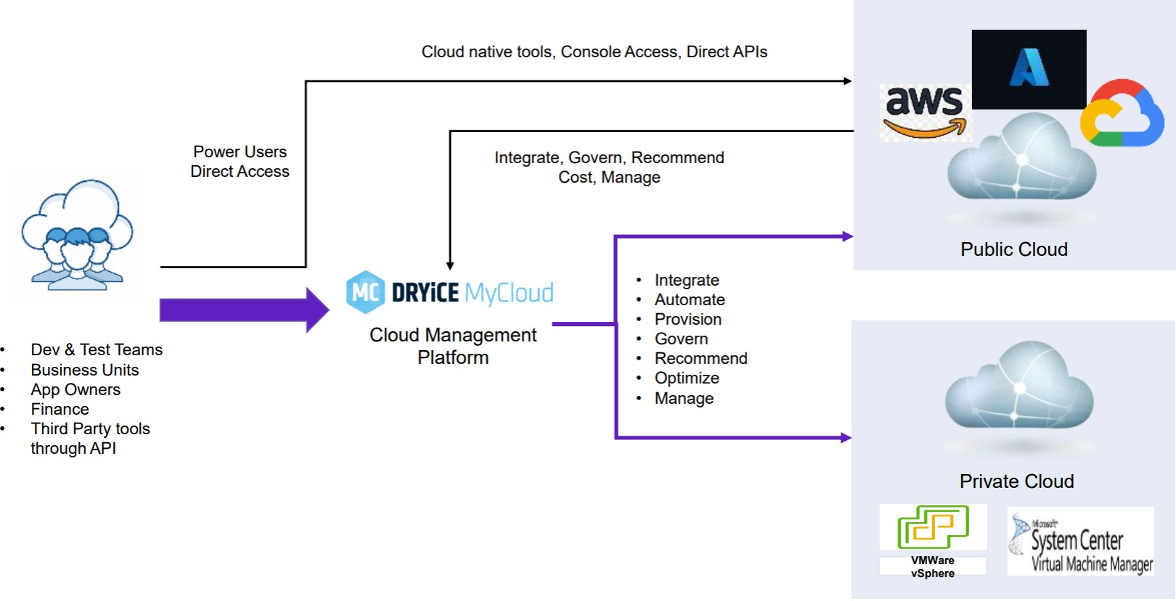
DRYiCE MyCloud workflow

Slide 44
Sustainability by Intel Gen 4 processor
Power/perf optimized to high density, ultra-efficient compute for cloud / hybrid cloud.
Perf/watt improvements (2.9x) – from the most built-in accelerators ever offered in an intel processor Ex: Integrated intel AMX (AI)
New optimized power mode (upto 70W) – delivers higher power savings with negligible performance impact on select workloads.
55% Lower TCO while reducing CO2 emissions
Built-in advanced telemetry - enables monitoring and control of electricity consumption and carbon emissions.
Manufactured at sites with state-of-the-art water reclaim facilities that in 2021 recycled 2.8 billion gallons of water

Slide 45
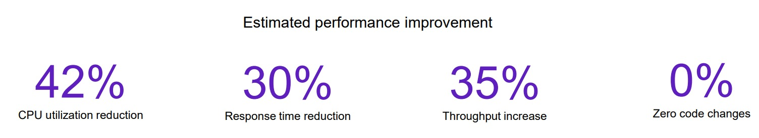
Savings calculator results
Cluster Size Reduction
Leverage Granulate performance improvements to run the same workload with less instances and better performance
Save On 3rd Party Costs
Save on 3rd parry costs by reducing cluster size: APM, logging, security and licenses
CO2 footprint reduction
Reducing the number of servers also has an environmental impacts, reducing CO2 emissions

Slide 46
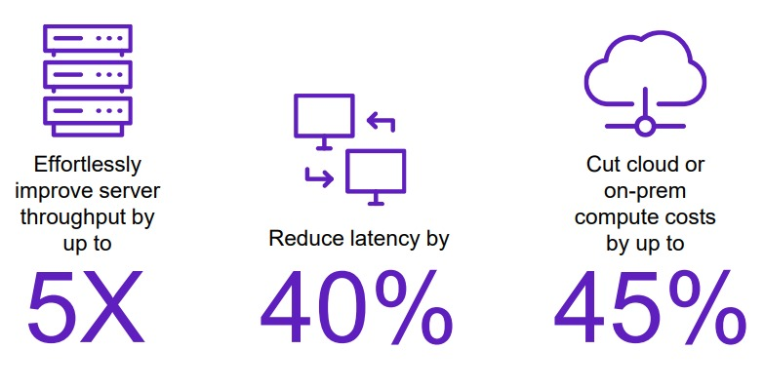
Sustainability by Granulate Solution
Continuous workload optimization
Intel Granulate, Intel’s real-time continuous workload optimizer, is a new approach to optimizing production workloads whilst reducing carbon footprint. It leverages resource usage patterns and data flow to automatically adapt OS and runtime level resource management to better fit an application’s needs.

Slide 47
What is Granulate?
An AI-driven backend to detect optimizations in the application runtime layer that can be implemented with zero code changes
optimizes specific application runtime environments to reduce cloud costs and enable organizations to do more with their existing budget.
update its optimizations in real time, eliminating a lot of the overhead involved with other solutions at the application layer

Slide 48
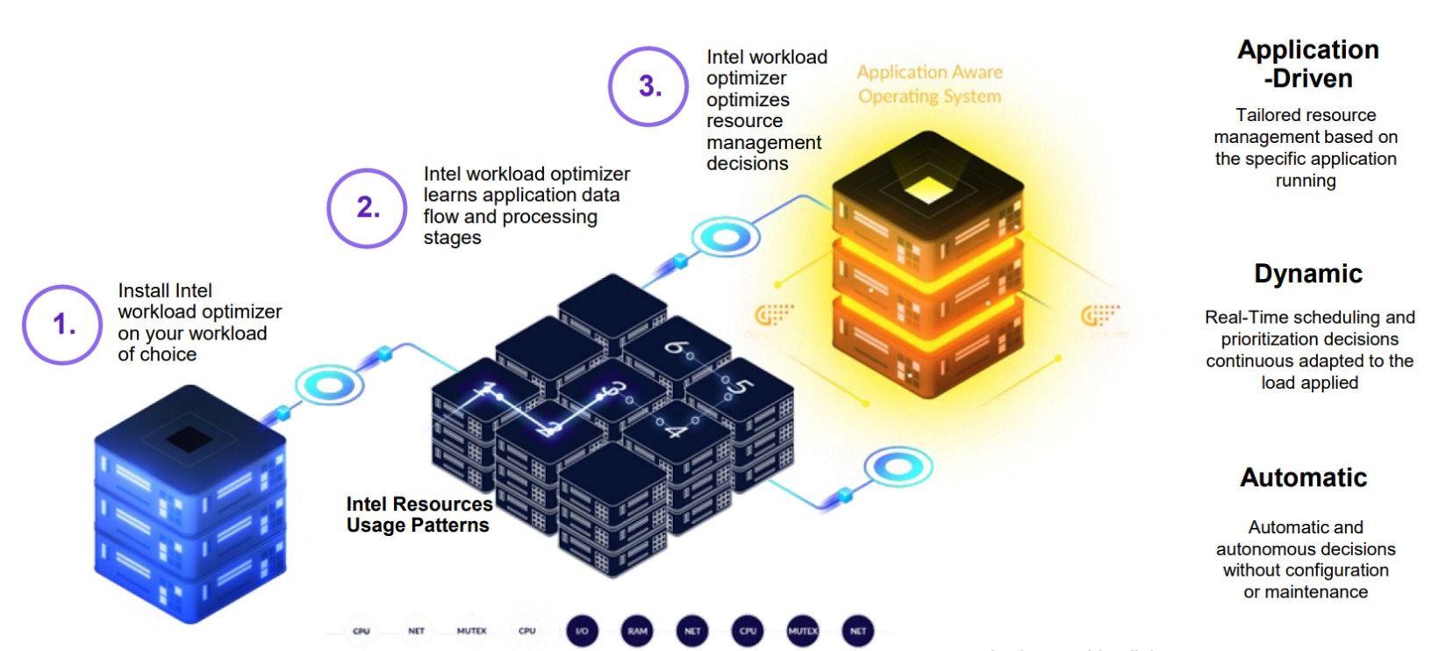
How does Granulate work?

Slide 49
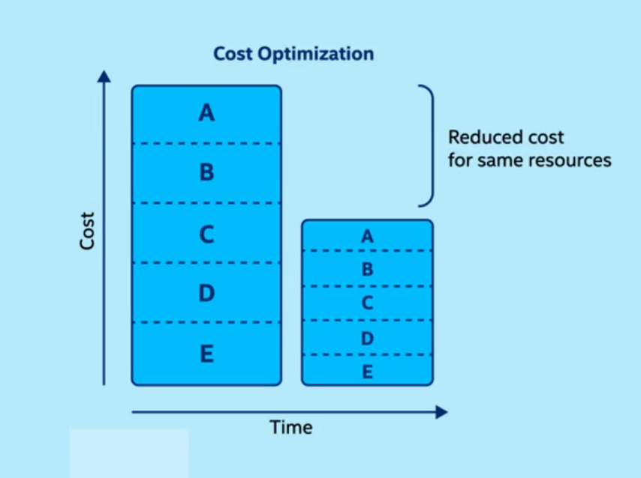
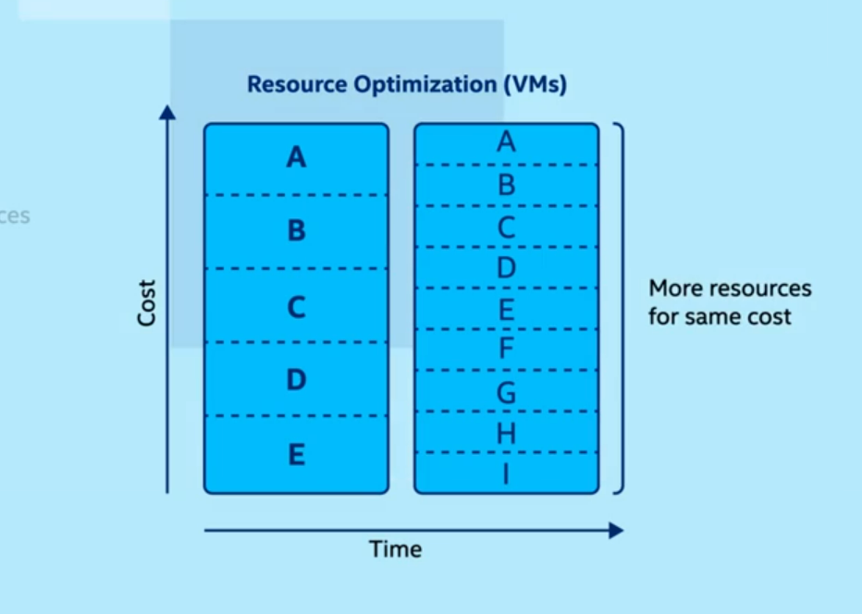
Two sides of a coin

Slide 50
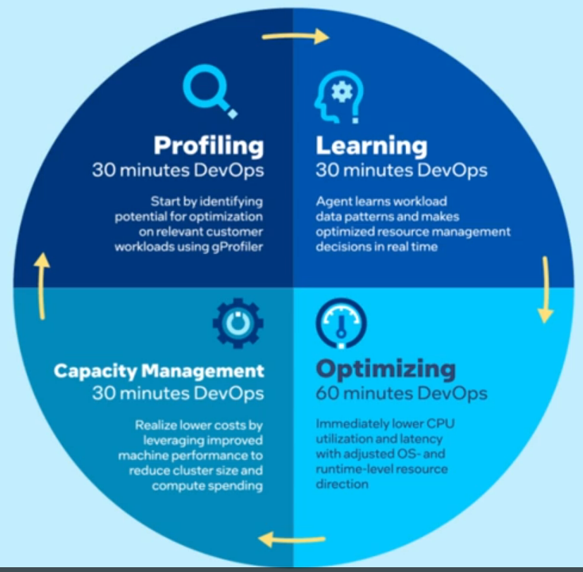
Operatrion/Workflow Cycle

Slide 51
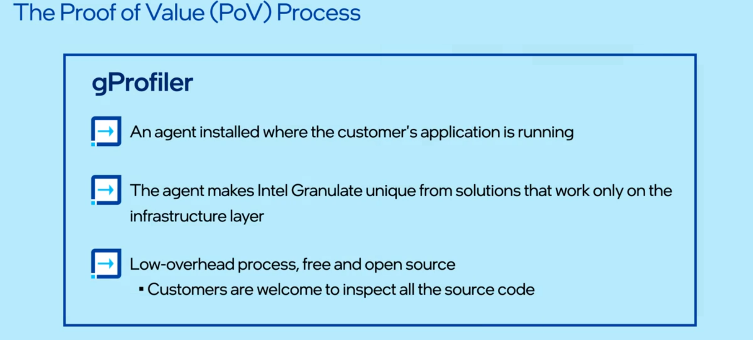
POV(Proof-Of-Value) Prove the specific value that Intel Granulate can provide the customer

Slide 52
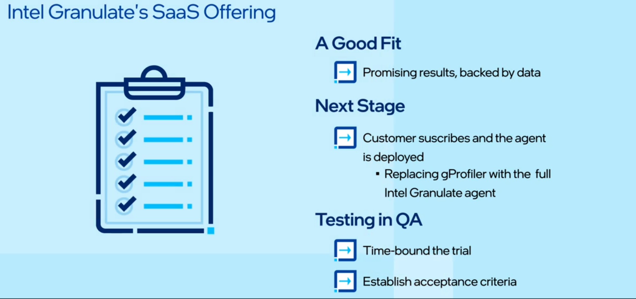
The Intel Granulate SaaS Offering
After the profiling is completed, the customer receives an optimization assessment, backed by data, showing whether the customer is a good fit for the Intel Granulate SaaS offering

Slide 53
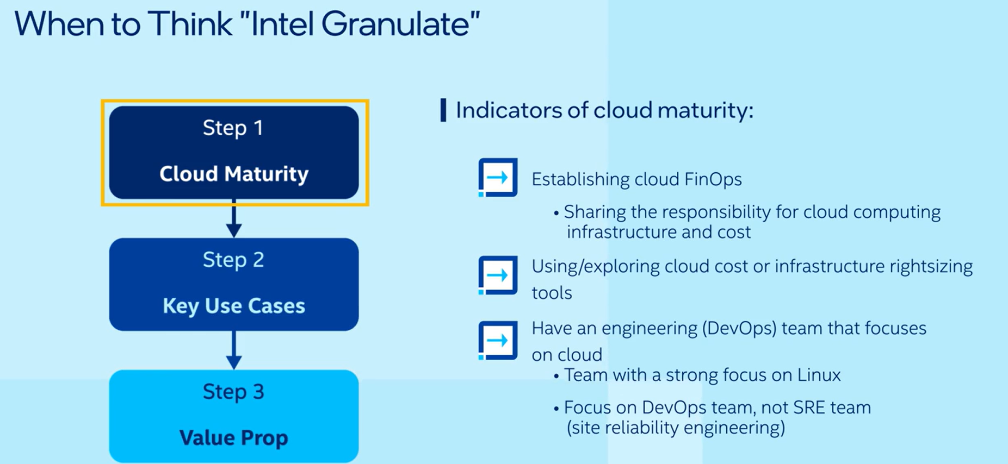
Potential Customer Guidance

Slide 54
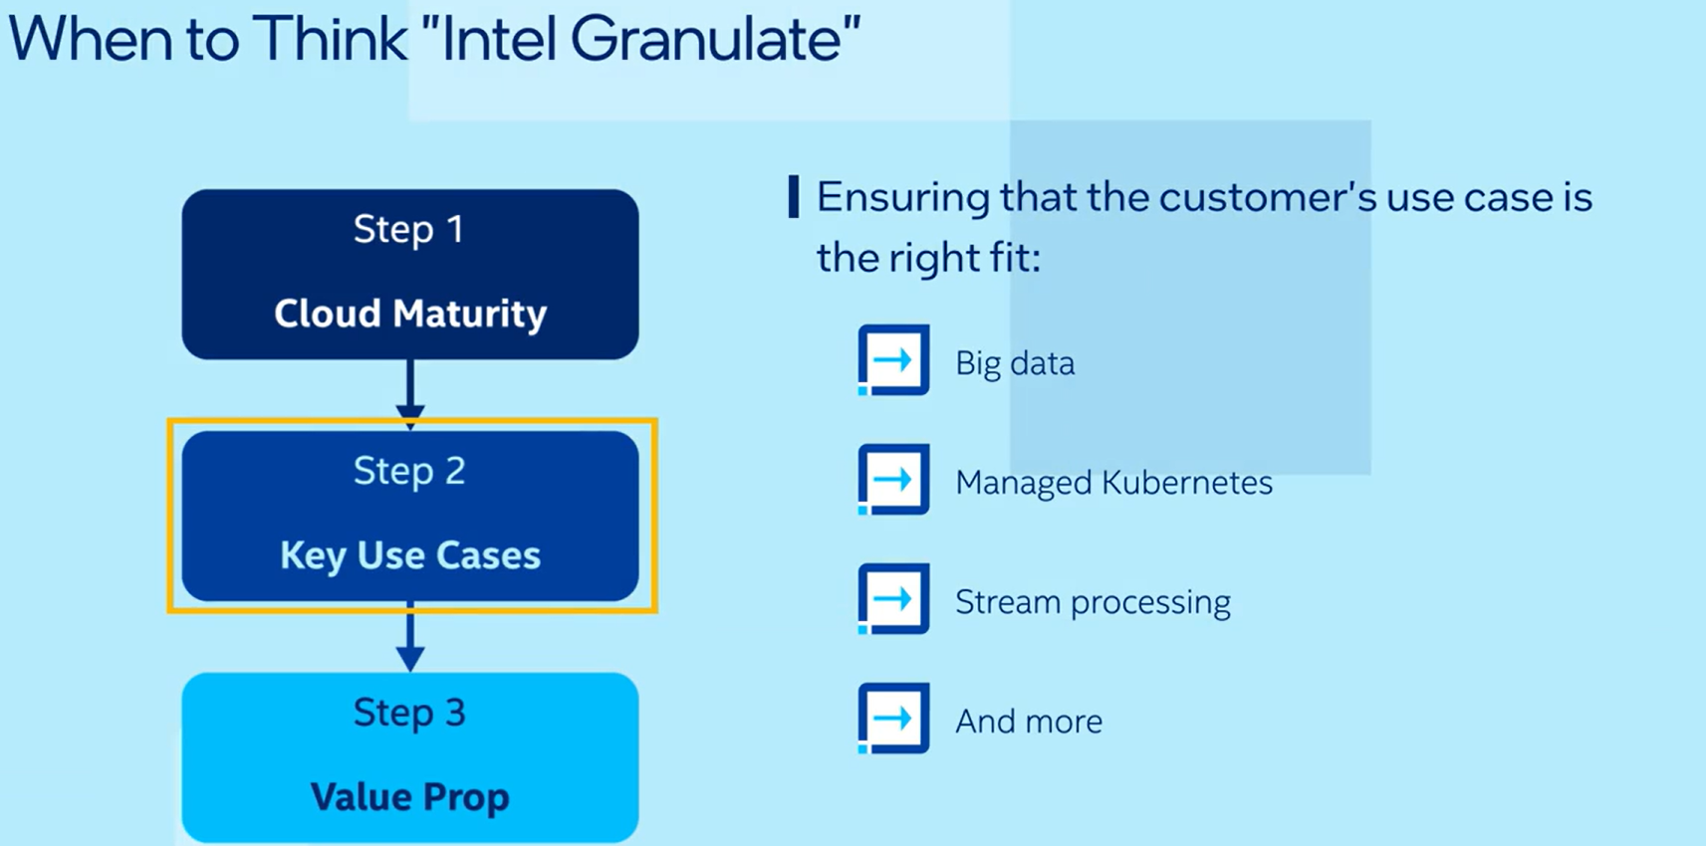
Potential Customer Guidance

Slide 55
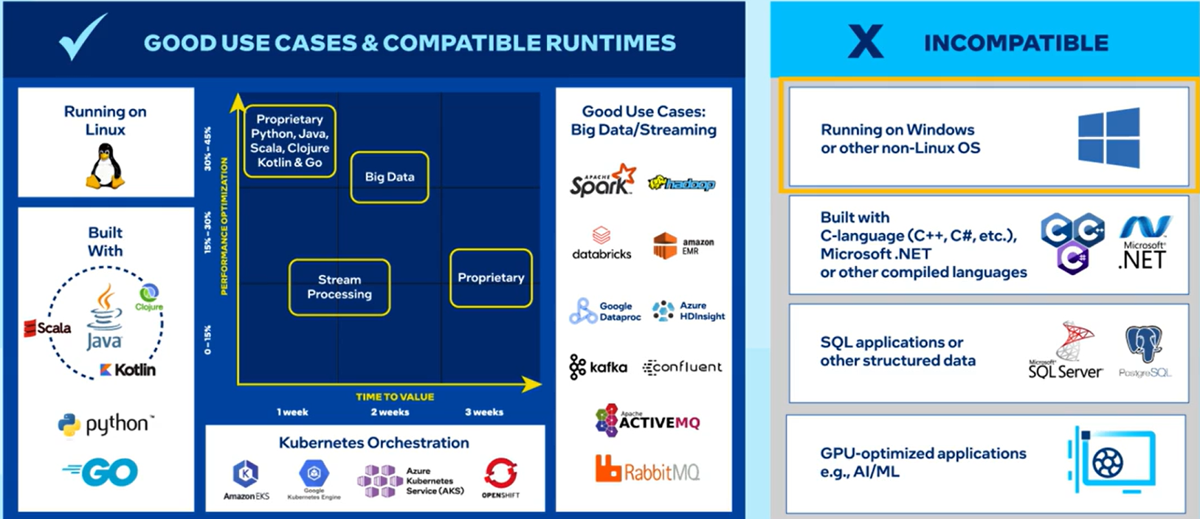
Compatibility/Non-Compatibility

Slide 56
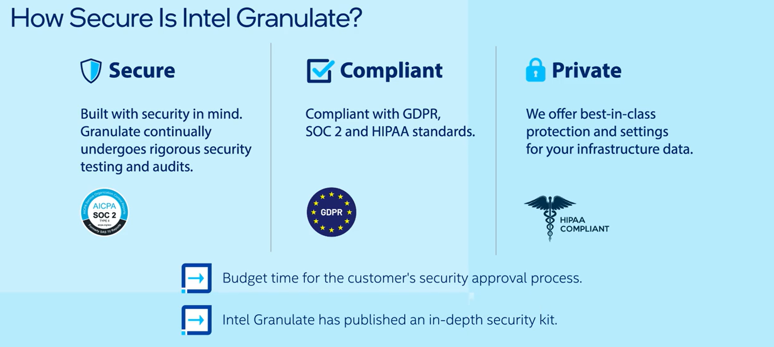
Security

Slide 57
Other Competitors
Different profiling tools that focus on profiling compute and memory that are available in the market today.
Google’s Cloud Profiler, that is a statistical and low-overhead profiler designed to continuously collect the CPU usage or memory allocation for an application in production. It associates the profiling information to the line of code or method that generated it, which helps discover which areas of the application are consuming the most resources. In terms of native application support, it supports Java, Go, Python and Node.js.
Datadog offers a continuous profiling service that can discover lines of code that have the highest CPU usage or memory allocation. The profiler is available with Datadog’s other agents that run on the application’s host and supports applications written in Java, Python and Go. One aspect of their profiling service is the profiling data differs based on the application language. For instance, collecting the time used per function in the CPU is available in all languages, but the profiling data for the time each method spends reading from and writing to files is only provided for Java applications.
.

Slide 58
Other Competitors
Amazon also has a service called CodeGuru. Among its many features, one specific feature helps developers understand the runtime behavior of an application in order to find the most expensive lines of code. You can use it to troubleshoot performance issues like high latency or low throughput by finding opportunities to improve CPU and memory utilization on applications written in Java and Python.
Dynatrace provides code-level diagnostic tools that can highlight problematic areas causing CPU or I/O bottlenecks. It offers CPU and memory profiling tools that allow developers to drill down to the method level to detect problems. The way to do this leverage is to proprietary technology to provide code-level traces that span an end-to-end transaction on applications written in Java, .NET, PHP, Node.js and Golang
.

Slide 59
Case Study -Success With a Global Commercial Airline
The deployment of Intel Granulate's solution resulted in significant cost savings of over 23% and improved job completion times within a short period, enabling the airline to enhance its operational efficiency.
This particular airline relies on a hyperscale cloud provider for its cloud infrastructure and services.
The Intel Granulate solution quickly optimized cluster performance, leveraging both runtime- and Databricks-level optimizations to reduce costs by an average of 23% across all Databricks clusters.
Through excellent coordination and project management from the airline’s data engineering team, the airline projects they will save a minimum of $400k a year on their Databricks infrastructure on a 250% Intel Granulate ROI.

Slide 60
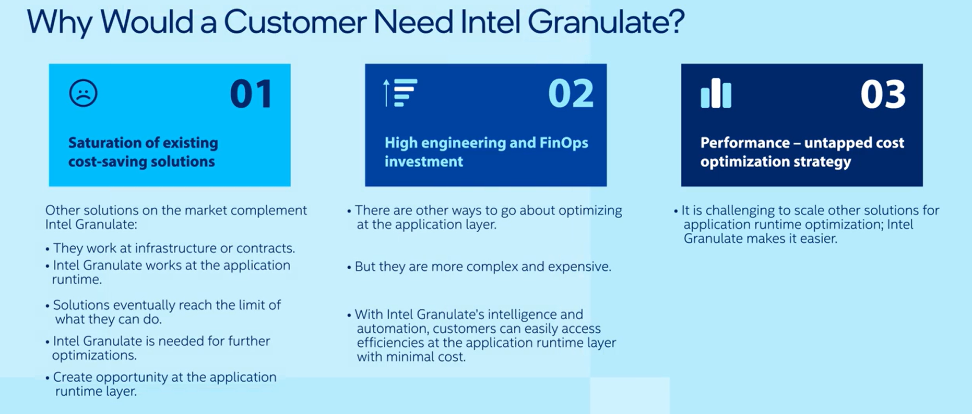

Slide 61
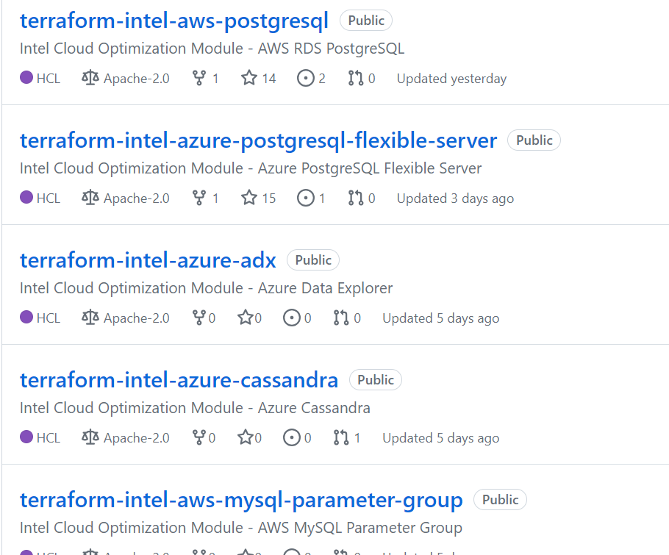
Intel OCR(Optimized Cloud Recipes)
Intel Optimized Cloud Recipes are
preconfigured templates designed to
optimize cloud workloads. These
recipes are tailored for several leading databases and can be easily integrated into
existing infrastructures. This reduces
time to market and costs while
improving performance.

Slide 62
Working of OCR Kubernetes Cluster Optimization for Intel® Hyper-Threading: Working Overview
Analysis and Identification:
Involves analyzing the existing configuration of the Kubernetes cluster.
Node hardware: Identifying the type of Intel® CPU processors and their Hyper-Threading capabilities.
Resource allocation: Evaluating how resources like CPU cores and memory are allocated to pods and containers.
Container scheduling: Analyzing the current container scheduling policies and their effectiveness

Slide 63
Working of OCR Kubernetes Cluster Optimization for Intel® Hyper-Threading: Working Overview
2. Optimization Actions:
Based on the analysis, the recipe implements various optimization actions:
Resource Quotas and Limits:
Setting resource quotas and limits for pods and containers prevents resource overutilization and ensures fair allocation.
This often involves setting specific limits for CPU cores, taking Hyper-Threading into account to optimize resource utilization.
Container Scheduling Policies:
The recipe configures container scheduling policies to leverage Intel® Hyper-Threading effectively.
This may involve prioritizing containers that benefit from Hyper-Threading and ensuring efficient CPU core allocation.
Node Pool Configuration:
Based on cluster needs and hardware capabilities, the recipe may adjust node pool configurations.
This could involve optimizing the number of CPU cores per node, enabling Hyper-Threading, and configuring scheduling constraints for specific node types.

Slide 64
Working of OCR Kubernetes Cluster Optimization for Intel® Hyper-Threading: Working Overview
3. Ongoing Monitoring and Adjustments:
The recipe can be integrated with monitoring tools to track resource utilization, application performance, and other key metrics.
Improved application performance: Efficiently utilizing Hyper-Threading technology can lead to faster application execution and increased processing power within the cluster.
Enhanced resource utilization: Optimized resource allocation ensures that CPU cores are used effectively, minimizing wasted resources and potentially reducing cloud costs.
Increased scalability: Optimizing the cluster allows it to handle more workload without needing additional resources.
Cost efficiency: By ensuring efficient resource utilization, the recipe can potentially lead to cost savings on cloud infrastructure.

Slide 65
Security Measures
Vigilant security guards for your VM that adhere to industry best practices, implementing robust security measures at both the data movement (Layer 4) and application (Layer 7) levels.
On one layer, it focuses on efficient movement of data ensuring a smooth delivery and on the another layer it pays attention to how the application interacts with the users.
Regular updates ensure a proactive defense against emerging vulnerabilities, creating a secure fortress for your cloud environment.

Slide 66
Optimization Methodology
Collaboration with CSPs: Intel worked closely with CSPs Amazon Web Services (AWS), Microsoft Azure, Google Cloud Platform (GCP), and others in conducting performance testing, and aligning on the best practices for optimizing workloads on Intel architecture.
Benchmarking: Intel benchmarked databases with stress testing and analyze the performance characteristics of various workloads.
Tuning and Configuration: Based on the performance benchmarking results, Intel had created optimized configurations which aims to maximize performance, reduce latency, and improve overall efficiency.

Slide 67
Maximizing Database Performance with Intel Optimized Cloud Recipes
By leveraging Intel Optimized
Cloud Recipes, HCL Tech Teams
can maximize database
performance by increasing
processing speed, reducing
latency, and improving scalability.
The result is faster data analysis
and better decision-making.

Slide 68
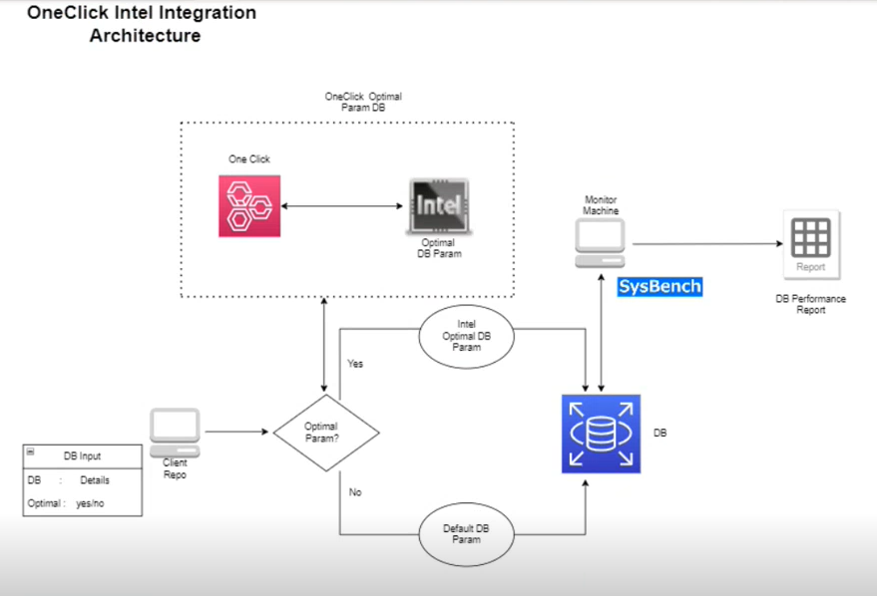
Maximizing Database Performance with Intel Optimized Cloud Recipes
HCL One-click integrated Intel Cloud Optimized Recipes to enhance the performance of databases within their workflows.

Slide 69
CPU & Memory Usage
Strike a delicate balance, optimizing these resources to enhance performance without compromising efficiency—much like a seasoned race engineer fine-tuning a race car for optimal speed and fuel efficiency
By leveraging Intel Optimize Cloud Recipes, HCL Tech Teams can maximize database performance by increasing processing speed, reducing latency, and improving scalability. The result is faster data analysis and better decision-making.

Slide 70
CPU & Memory Usage Real-Time Video Captioning: Standard vs. Intel Optimized Cloud Recipe Comparison
Cloud Platform: Google Cloud Platform (GCP)
Tools: | Standard Cloud Recipe: Utilizes Tesseract OCR library for text recognition within a Cloud Foundry application. Intel Optimized Cloud Recipe: Leverages Intel® Media SDK with integrated OpenCV libraries and hardware acceleration features like Intel Deep Learning Boost (DL Boost) for text recognition and video processing.
Hardware: | CPU: Intel Core i7-11800H @ 2.30GHz (8 cores, 16 threads) RAM: 16GB DDR4 Operating System: Ubuntu 22.04 LTS
Measurements: | CPU Usage: Average and peak percentages over a continuous 5-minute video captioning session. Memory Usage: Maximum memory footprint observed during execution.

Slide 71
Metric | Standard Ccloud Recipe | Intel Optimized Recipe | Improvement
Average CPU Usage | 82% | 65% | 17%
Peak CPU Usage | 95% | 78% | 17%
Maximum Memory Usage | 850 MB | 720 MB | 15%
Explanation:
CPU Usage: Intel Optimized Ccloud Recipe shows a significant reduction in average and peak CPU usage compared to the standard recipe. This is primarily due to:
Hardware acceleration: Intel Media SDK leverages DL Boost and other hardware features to accelerate video processing and OCR tasks, reducing CPU workload.
Optimized libraries: OpenCV offers efficient algorithms for video analysis and frame processing, contributing to lower CPU consumption.
Memory Usage: While the memory usage reduction is moderate, the Intel Optimized recipe still manages to be slightly more efficient due to optimized memory management within its libraries.
Overall Performance: Intel Optimized Ccloud Recipe achieves smoother video captioning with lower CPU and memory utilization, potentially leading to reduced costs on cloud resources.

Slide 72
Other Players
Players | Description | Strengths | Weaknesses | Use Cases
AWS CloudFormation & Templates | Built-in AWS resource configuration and automation tool. | Deep integration with AWS platform. Extensive documentation and community resources. | Limited to AWS platform (no multi-cloud). . Focuses primarily on infrastructure, not performance optimization. | AWS-specific deployments. Infrastructure automation and configuration.
Ansible | Open-source automation platform for configuration management. | Flexible and powerful automation capabilities. Large community and ecosystem of modules used with various configurations including cloud platforms. | Can be complex for large deployments. Not explicitly focused on cloud or Intel® technologies. | Infrastructure and application configuration management. Automation of complex IT tasks.
CloudBolt | Cloud management platform (CMP) with IaC and automation capabilities. | Unified management interface for multiple clouds. * Pre-built automation workflows for cloud tasks, inntegrated with various monitoring and management tools. | Vendor-specific platform (not open-source). Higher cost compared to open-source alternatives. May not be as flexible as tool-based approaches. | Hybrid and multi-cloud management. Cloud cost optimization and governance.

Slide 73

Observations/ Work experiences during the internship

Slide 74
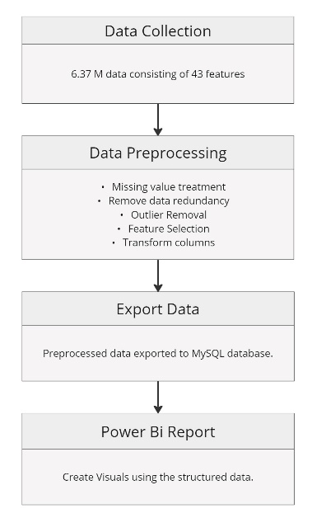

Conducted extensive gap analysis on various ISV Ecosystems, using Python and SQL.
Collaborated with the Executive teams, to develop solutions having INTEL Value adds.

Slide 75
Internship Observations
Technical understanding of Intel technologies – and optimizing the engagement, adoption of these technologies.
Active contribution in value creation, technical documentation of HCLTech & Intel Joint Solutions
Collaborate with cross-functional teams to integrate solutions effectively
Accelerate the process from the solution creation to the GTM launch
Creation of marketing collaterals to promote the solutions internally & externally
Enable sales, presales and practice teams with latest Intel solutions
Ideate and Execute on innovative methods to ensure adoption of Intel technologies across BU’s / Developer ecosystem at HCLTech
Organize Webinars and plan training bootcamps
Marketing plan to ensure latest technologies are visible and consumable.
New Initiatives.
Notes:
Add a page for all links to the work done/ add links to the work
Planning & Preparation
Training & Enablement --> Workshop & Webinars
Analysis
Gap Analysis --> Defining objectives --> Setting Goals -->
Execution
Solution offerings ( Technically, Compliance, marketing/collateral pov, GTM pov)--> Technology/awareness --> Value creation for Intel EKM page (case studies) --> Engagements/Hackathon
Impact
Conclusion & Next Steps
Feedbacks & Suggestions

Slide 76
Training & Enablement
Intel Partner Certification
Successfully completed Intel Partner Certification courses
Intel Granulate
Intel Trust Authority
to understand Intel and hybrid cloud domain, gaining deeper insights into Intel cloud optimization tools.
Explored the collaboration between Intel and HCL with Intel EBU framework
HCLTech Workshops & Webinars attended
Use Intel-Optimized AI Software
Intel Ambassador January Training- 5th Gen Xeon Launch
Key Takeaways - These sessions provided valuable insights into process gaps and sparked ideas for innovative solutions based on the presentations and discussions during the workshops and webinars.
Notes:
Add a page for all links to the work done/ add links to the work
Planning & Preparation
Training & Enablement --> Workshop & Webinars
Analysis
Gap Analysis --> Defining objectives --> Setting Goals -->
Execution
Solution offerings ( Technically, Compliance, marketing/collateral pov, GTM pov)--> Technology/awareness --> Value creation for Intel EKM page (case studies) --> Engagements/Hackathon
Impact
Conclusion & Next Steps
Feedbacks & Suggestions

Slide 77
Technical runbooks of Intel products & solutions
Intel Product Insights
Brief slides on each of the Intel Products
Presented it to the internal team for technical discussion
Topics Covered :
Intel Granulate
Intel OCR(Optimised Cloud Recipes)
Confidential Computing Plan 2024
Key Takeaways
Creation of technical slides for quick reference and understanding of technology usage
Identified use-cases for each technology to accurately position the products across domains
Addressing technical challenges/pain points
Comparison of opensource vs Intel distributions based on standard benchmarks
Analyzing Intel value-add for the products
Notes:
Add a page for all links to the work done/ add links to the work
Planning & Preparation
Training & Enablement --> Workshop & Webinars
Analysis
Gap Analysis --> Defining objectives --> Setting Goals -->
Execution
Solution offerings ( Technically, Compliance, marketing/collateral pov, GTM pov)--> Technology/awareness --> Value creation for Intel EKM page (case studies) --> Engagements/Hackathon
Impact
Conclusion & Next Steps
Feedbacks & Suggestions

Slide 78
Gap Analysis
Goals
Approach
Key Takeaways
Enabling internal teams to deliver best in market solutions with access to Intel SMEs.
Understand problem statements, and recommend respective Intel solutions
Understand existing HCL solutions and integrate Intel value adds
Identify the areas of interest and create resources
Identified the different teams within HCLTech and understood their roles and domain.
Analyzed where the offerings could be packaged with the Intel Processor, software or toolkits to enhance performance and bring better value to customers
Worked with cross functional teams including Intel, CoE, PMG & Marketing for solution collateral and promotional materials
Arranged the implementation steps into 3 divisions:
Promotions
Internal - Webinar
External – Case Studies
Breakthrough ideas
Intel EBU Hackathon
Intel Innovation Day
Yammer Communities
78
Notes:
Add a page for all links to the work done/ add links to the work
Planning & Preparation
Training & Enablement --> Workshop & Webinars
Analysis
Gap Analysis --> Defining objectives --> Setting Goals -->
Execution
Solution offerings ( Technically, Compliance, marketing/collateral pov, GTM pov)--> Technology/awareness --> Value creation for Intel EKM page (case studies) --> Engagements/Hackathon
Impact
Conclusion & Next Steps
Feedbacks & Suggestions

Slide 79
Solution Development
Goals :
To understand the HCL existing solutions like Confidential Computing, Intel Granulate, and Intel OCR
Assist in proposal, technical architecture, POC(Proof-Of-Concept), documentation & marketing collaterals
Align the offerings for added benefit to HCL clients, and enhance the portfolio

Slide 80
Solution Development
Goals :
To understand the HCL existing solutions like Confidential Computing, Intel Granulate, and Intel OCR
Assist in proposal, technical architecture, POC(Proof-Of-Concept), documentation & marketing collaterals
Align the offerings for added benefit to HCL clients, and enhance the portfolio

Slide 81
HCLTech - Intel EBU Joint Solutions
Intel EBU Joint Solutions
Confidential Computing
HyClass & HyRise
Notes:
Template 1

Slide 82
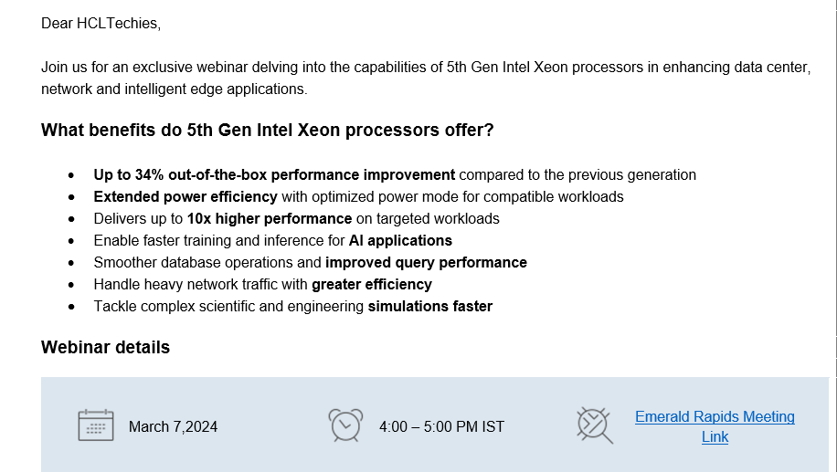
Emerald Rapids Xeon 5th Gen- Webinar
Notes:
Template 1

Slide 83
Promotions
Goals :
To ensure that the solutions are being promoted across internal & external platforms
Generate content which will help the teams to adopt the various EBU offerings, understand and sell it better

Slide 84
Internal Promotions
Case Study | HCL Tech Optimizes Cloud Costs with Intel Cloud Optimizer and Densify | 15th March, 2024
Blog | Embracing Sustainability with HCLTech‘s Hybrid Cloud as a Service | 12th March, 2024

Slide 85

What skills (scientific and professional) were learned during the internship

Slide 86

Statistical Gap Analysis
Data Cleaning and Preprocessing
Scientific Skills
Data Visualization
Sales & Solution Development
Machine Learning Techniques

Slide 87
Project Management
Problem-solving
Professional Skills
Communication Skills
Adaptability
Professionalism

Slide 88
Key Achievements
Successfully completed 3 certification course
Actively conducted many workshops and webinars
Conducted comprehensive surveys, gathering valuable insights from over 30 members in the cloud services domain.
Built a POC on Confidential Computing for Intel Vision 2024.
Drafted compelling content for over 12 newsletters, ensuring effective communication and engagement.
Facilitated Confidential Computing and Intel EMR walkthrough sessions.
Compiled and documented impactful case studies for hosting on the HCLTech website

Slide 89
Key Learnings
Understanding Intel's ecosystem: Insight into Intel's partnerships, products, and technologies.
Collaborative teamwork: Effective collaboration with diverse teams from HCL and Intel.
Technical skills enhancement: Acquired proficiency in Intel products, solutions, and platforms.
Problem-solving and analytical thinking: Strengthened problem-solving and analytical skills for real-world challenges.
Adaptability and flexibility: Successfully adapted to dynamic project requirements and embraced change.
Effective communication: Improved communication skills for stakeholder interactions and presentations.
Business acumen and customer focus: Understanding business needs and aligning solutions with customer expectations.
Project management: Hands-on experience in project planning, execution, and monitoring.
Industry exposure and networking: Knowledge of industry trends and expanded professional network.
Continuous learning and growth mindset: Embracing a mindset of continuous learning and staying updated with industry advancements.

Slide 90
Recommendations
Engagement
Sales interactions can be an area of focus, as that team would be beneficial in driving more leads to Intel.
Frequent engagements and promotions are required for better reach and awareness
Enhance social media promotion for Intel EBU to increase visibility and reach. Improve the interactivity of the Intel ecosystem webpage to engage users and provide valuable information.
Technology
GTM ready solutions : Granulate, HyClass & Confidential Computing – are complete packaged solutions from Intel. They have 3 months free PoC – which can be utilized effectively for better reach, more RFPs ; and provide optimization across enterprises (this could be a big differentiator)
Confidential Computing – Zero-trust Intel security model can be adopted to ensure a consistent security posture in all customer/client test cases

Slide 91
Opportunity for HCLTech to engage with Intel
Leveraging Intel's cutting-edge technologies to drive innovation and enhance solutions in emerging technologies:
The confidential computing market size is expected to grow from USD 5.3 billion in 2023 to USD 59.4 billion by 2028 at a Compound Annual Growth Rate (CAGR) of 62.1%
The global AI (chipsets) market is valued at USD 18.6 billion in 2023 and is projected to reach USD 64.5 billion by 2028 and grow at a CAGR of 28.1% from 2023 to 2028
Machine Vision Market Size Worth USD 16.82 Billion by 2030 , expected to exhibit CAGR of 8.2% During 2023-2030
Key areas to Focus on offerings
First to market on Confidential computing with solutions like Trust-as-a- Service (Amber)
Intel workload optimizer Granulate Unique solution with no competition
Private 5G solutions (Bevo lake, FlexRAN) with open standards and interoperability developed in collaborations of network equipment manufactures and services providers.
Intel Geti -Intel’s computer vision platform for developing AI models so that enterprise teams can teach machines to do visual tasks
Collaborating with Intel empowers HCL technologies to enhance performance, scalability, security and unlocking new opportunities for innovation.

Slide 93

Concluding Remarks (Challenges faced)

Slide 94
Understanding Domain Knowledge – Intel and Its Offerings
Learning domain knowledge of Intel’s offerings in collaboration with HCLTech
Proactive engagement with subject matter experts and extensive research facilitated a deep understanding of previous solutions developed.
Overcoming this challenge underscored the importance of interdisciplinary collaboration and adaptability in dynamic work environments.
Certifications
Intel Granulate
Intel OCR
Intel Trust Authority.

Slide 95
Trust-as-a-Service
Learnt about the concept of Confidential Computing.
Utilized online resources, documentation, and collaboration to deepen understanding of GCP VM features.
Launched the service of Confidential Computing employing GCP’s secured VM and Intel SGX.

Slide 96
Optimizing the Code for Confidential Computing Service
Overcame challenges in optimizing code for handling cyber threats
Engaged in comprehensive code review sessions, identifying bottlenecks and implementing algorithmic optimizations, parallel processing techniques, and memory management strategies.
Collaboration with senior colleagues and continuous learning led to significant improvements in code performance, enhancing speed and scalability of data analysis pipeline, reinforcing the importance of innovation in overcoming complex challenges.

Slide 97

References

Slide 98
https://hcltech.com/
https://intel.com/
https://www.incona.se/
https://www.freepik.com/
Akter, Nargis & Johnston, D. & Niang, M. & Jurji, Z. & Khan, E.R. & Rahman, M.S. & Khan, T.M.S. & Islam, Md Tahmidul & Ahmed, K.M. & Bhattacharya, Prosun. (2024). System strengthening and scaling up drinking water safety and reduction of the risks of arsenic in the communities of Bangladesh. 10.1201/9781003317395-175.
Khan, E.R. & Rahman, M.S. & Khan, T.M.S. & Dey, B.C. & Akter, Nargis & Niang, M. & Johnston, D. & Islam, Md Tahmidul & Ahmed, K.M. & Alam, M.J. & Bhattacharya, Prosun. (2024). Screening of water points as first step for effective arsenic risk reduction in Bangladesh. 10.1201/9781003317395-176.
Ahmed, K.M. & Alam, M.J. & Woobaidllah, A.S.M. & Akif, M.M.A. & Bishal, M.M. & Rahman, I. & Bhattacharya, Prosun & Islam, Md Tahmidul & von Brömssen, Mattias & Sharma, Sanjeev & Khan, E.R. & Akter, Nargis. (2024). Preliminary investigations to assess potentialities of applying the SASMIT protocol in three contrasting hydrogeological environments in Bangladesh. 10.1201/9781003317395-177.

Slide 99
Alam, M.J. & Ahmed, K.M. & Akif, M.M.A. & Bishal, M.M. & Rahman, I. & Bhattacharya, Prosun & Islam, Md Tahmidul & von Brömssen, Mattias & Sharma, Sanjeev & Khan, E.R. & Akter, Nargis. (2024). Drillers mapping – as supportive tool to assess local hydrogeologic setting to enhance private sector capacity for scaling up safe water access. 10.1201/9781003317395-178.
Basak, S. & Sharma, Sanjeev & Bhattacharya, Prosun & Islam, Md Tahmidul & Ahmad, A. & von Brömssen, Mattias & Ahmed, K.M. & Alam, M.J. & Akter, Nargis. (2024). Developing machine learning approach for predicting groundwater quality based on arsenic and other major contaminants data to accelerate the SDG 6.0 agenda on drinking water safety. 10.1201/9781003317395-180.

Slide 100

- By Samarjeet Singh

